Slide 1
Structured Programming Language Lab Multidimensional Arrays

Slide 2
Instructions
First see the example (in slide 3). Run it and make sure you understand what is going on.

Slide 3
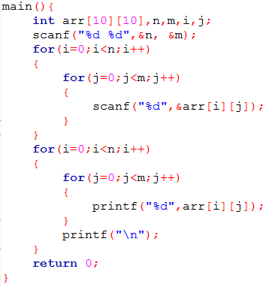
Example

Slide 4
Try yourself
Take N rows and M columns of numbers as input in an 2d array and then print rows in reverse.
Take N rows and M columns of numbers as input in an 2d array and then print columns in reverse.
Take N rows and M columns of numbers as input in an 2d array and then sum all the numbers and print the summation.
Take N rows and M columns of numbers as input in an 2d array and then print the summation of each row.
Take N rows and M columns of numbers as input in an 2d array and then print the summation of each column.
Take N rows and M columns of numbers as input in an 2d array and then check if it’s a diagonal matrix.
Take N rows and M columns of 0s and 1s as input in an 2d array and then check if it contains only 1s.
Take NxNxN cube as input and print it.

